Slide 1
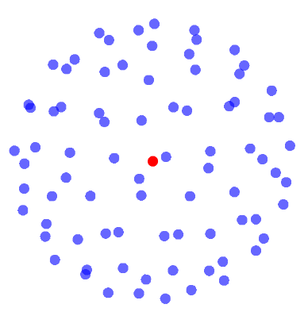
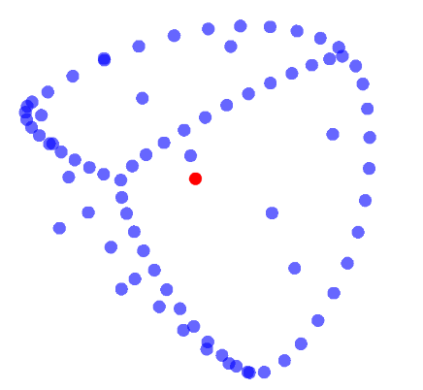
DRP 2025
Project by Charles-Étienne Lessard
mentored by Miguel Ayala

Slide 2
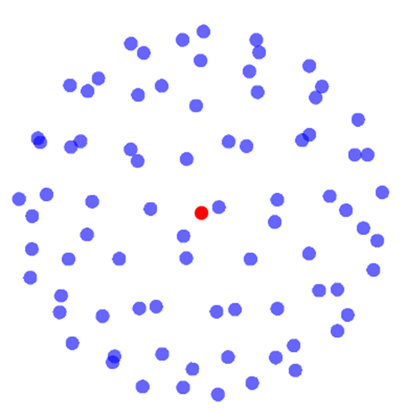
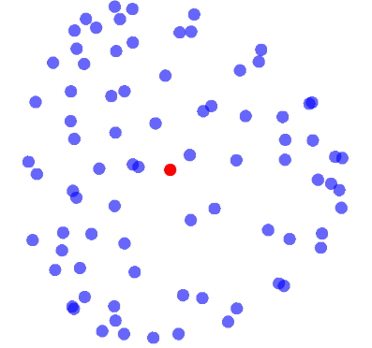

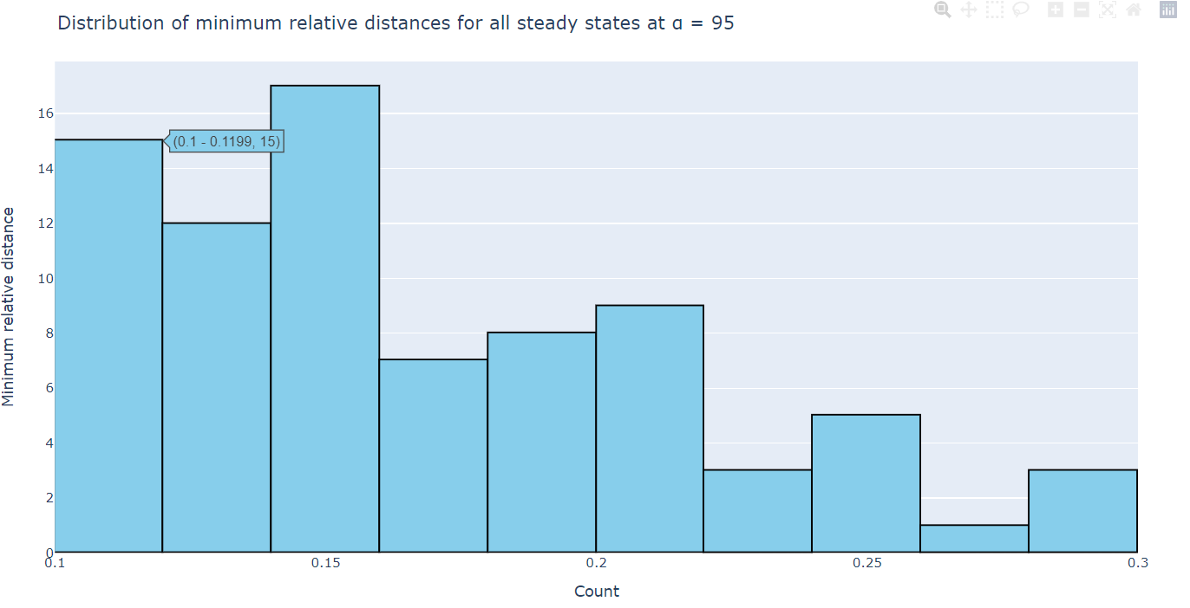
Computational Mathematics:
Another way of exploring math
Approximate solutions to complicated differential equations
Efficient visualization tools
Modelling and prediction (when equations become imposible to solve by hand.

Slide 3
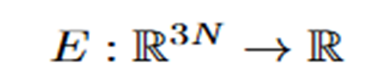
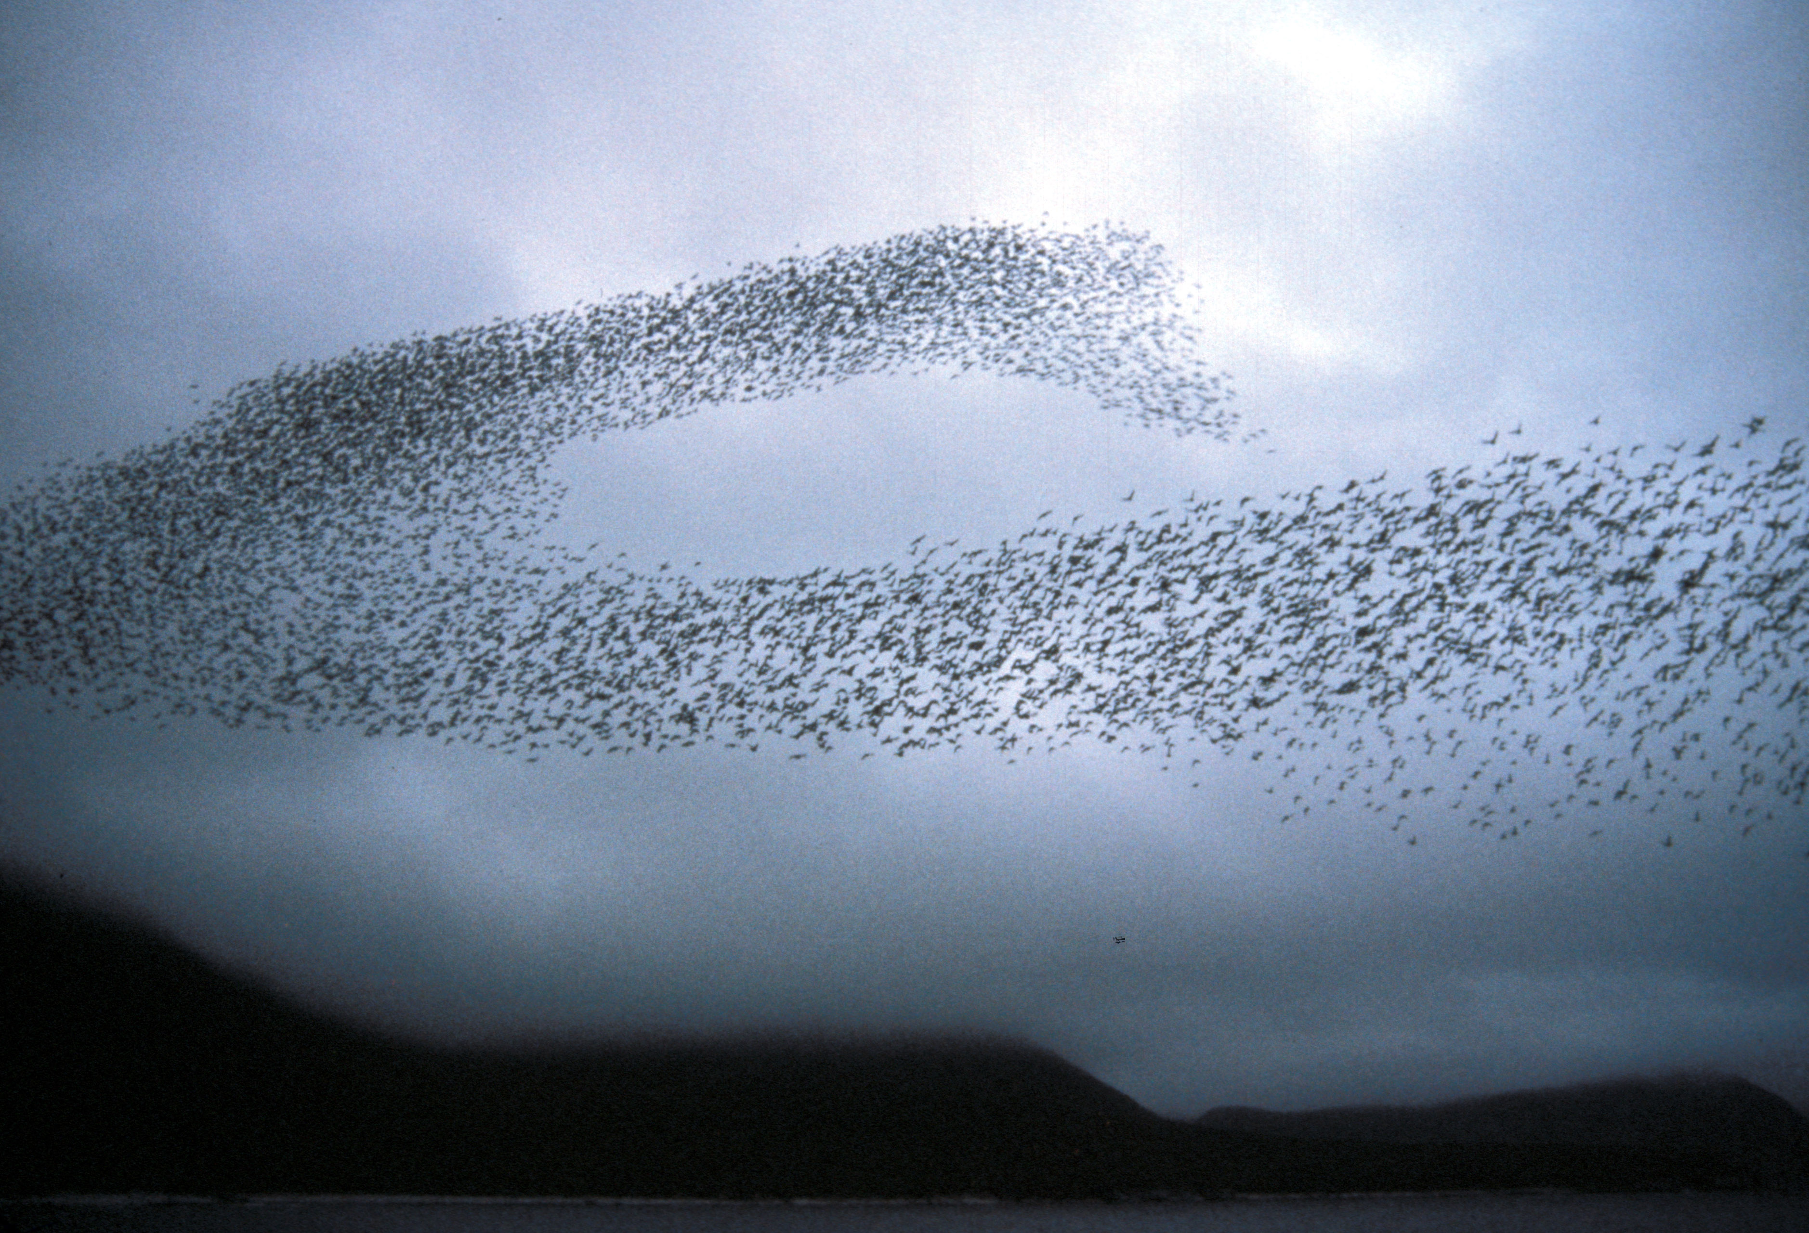
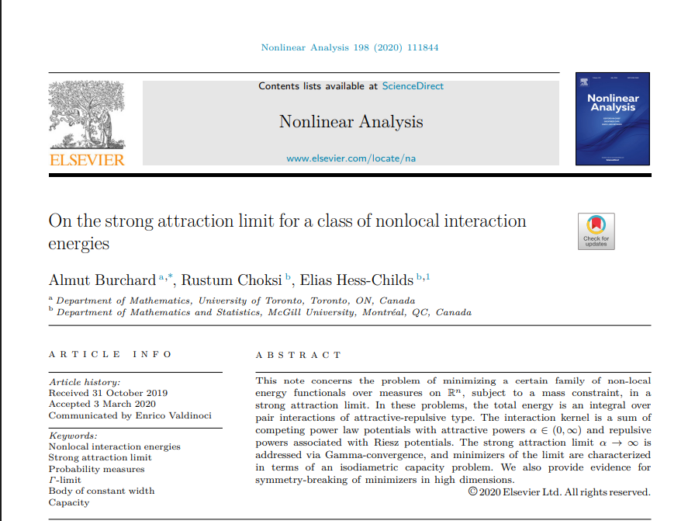
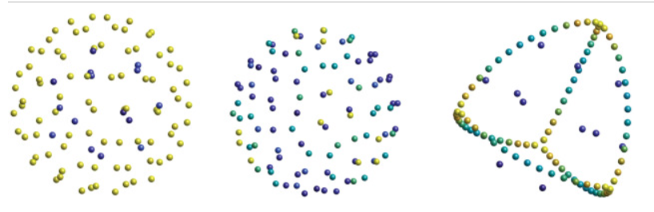
https://www.sciencedirect.com/science/article/pii/S0362546X20301036
Our project : Study the break of symmetry of a particle system
Energy Function:

Slide 4
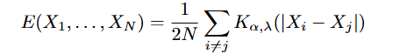
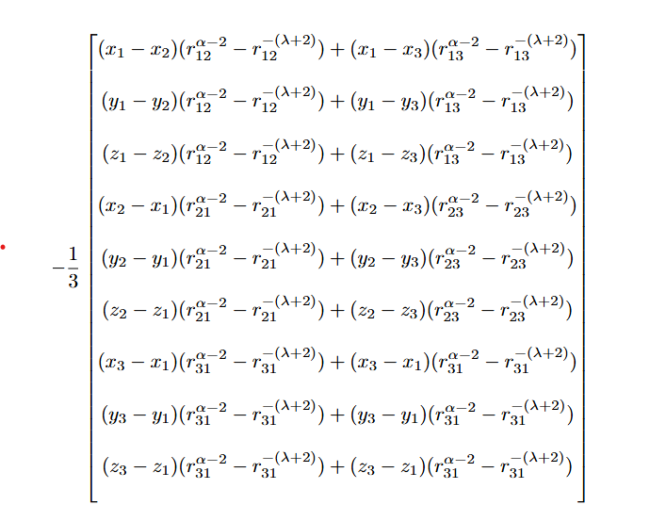
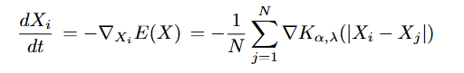
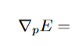
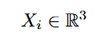
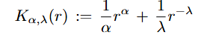
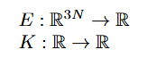
Finding the Minimizers
Energy Function:
Example: N = 3
Gradient of Energy Function:
Interaction Kernel
λ > 0 and α > 0

Slide 5
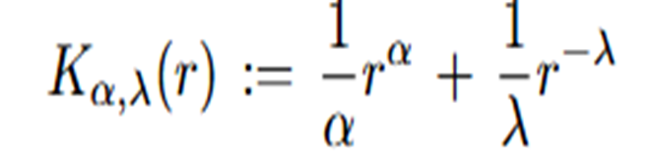

What can we explore?
Interaction Kernel
Which quantitative measurements can we take on the shape of the local minimizers?
How does the variation of the parameters affect the shape of the minimizers?
Does the number of particles have an influence on the shape of the minimizers?

Slide 6
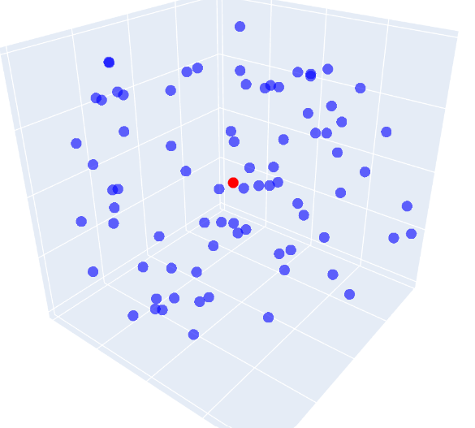
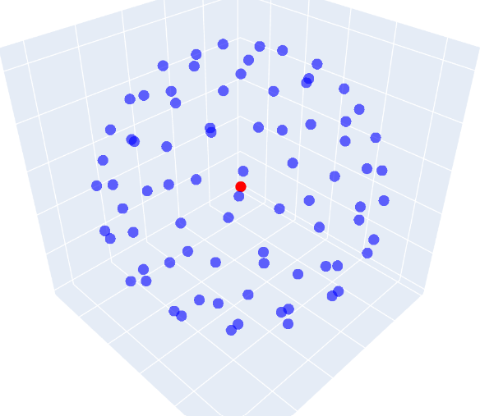
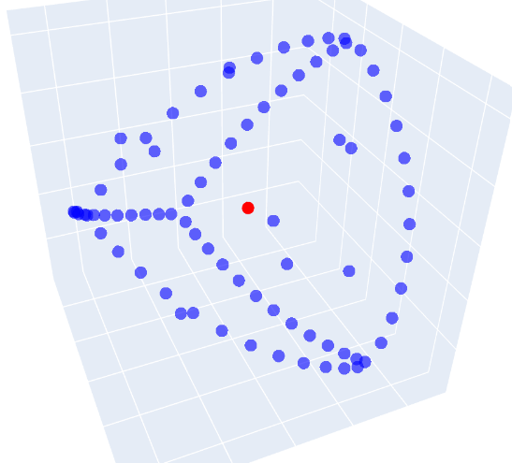
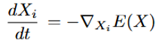
How does a solver work?
Random Initial Condition
Small value of α
Large value of α
Solve the ODE system
Continuation

Slide 7
1.How does the variation of the parameters affect the behaviour of the minimizers?
Put pluto demo

Slide 8
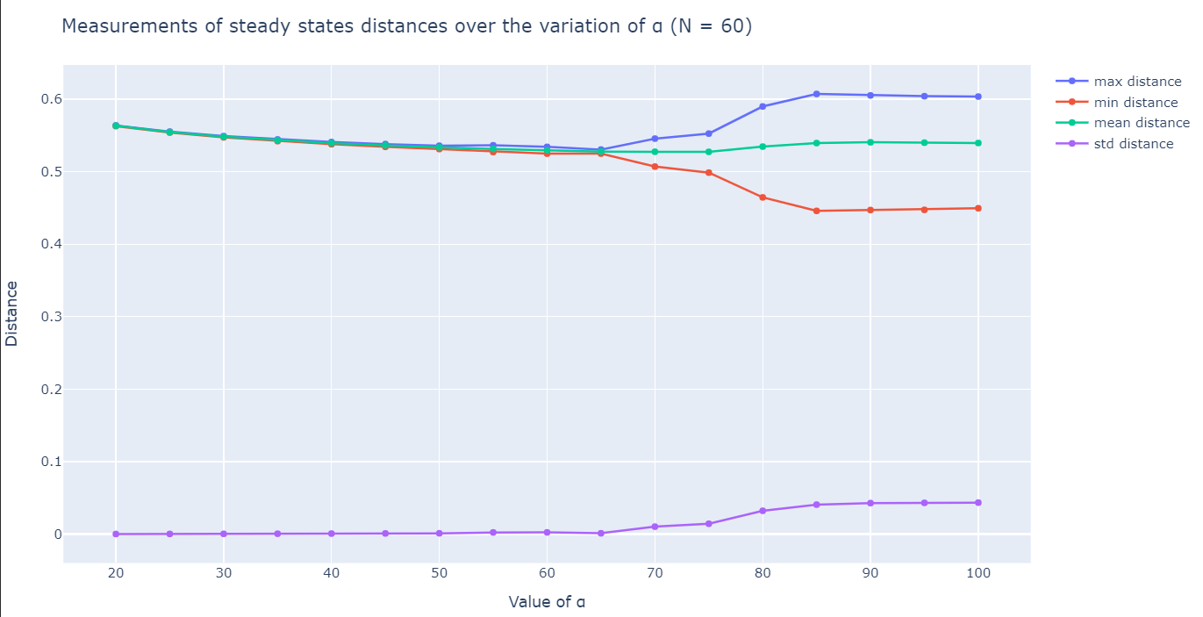
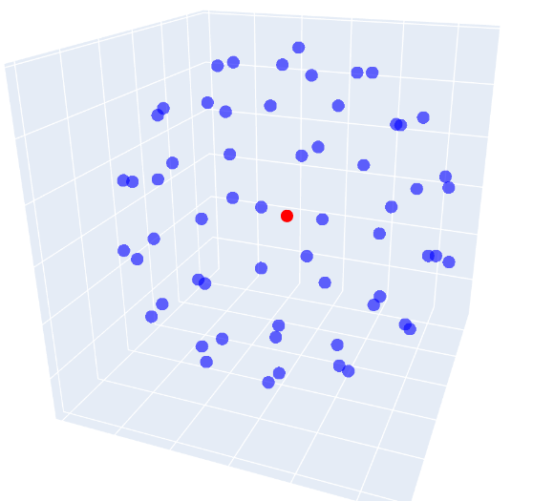
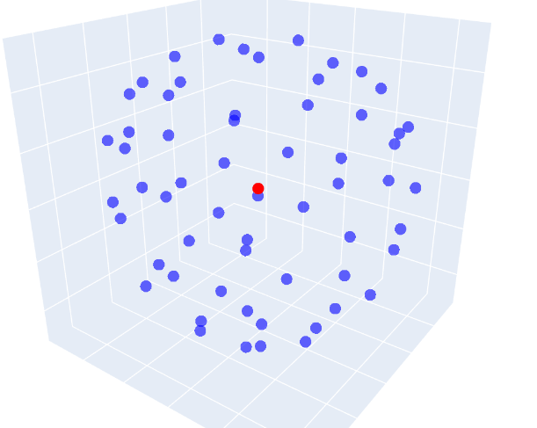
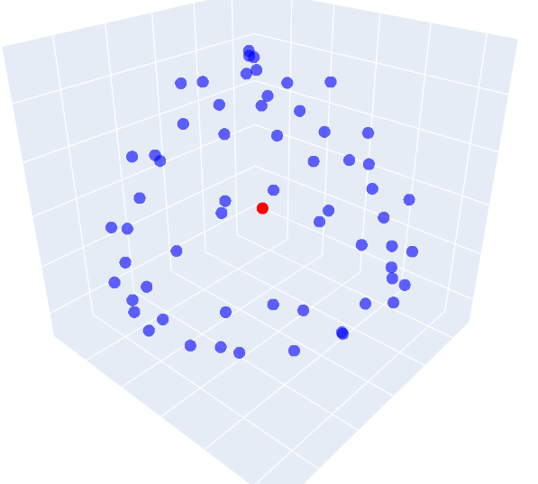
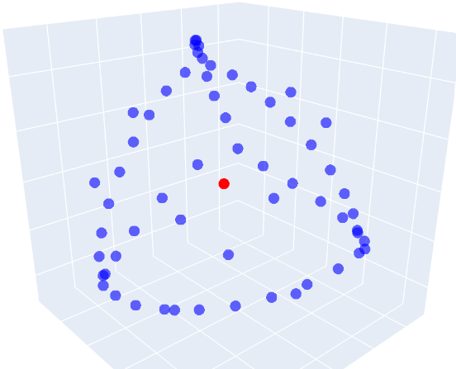
2. How does the variation of the parameters affect the shape of the minimizers?
α = 20
α = 75
α = 80
α = 100

Slide 9
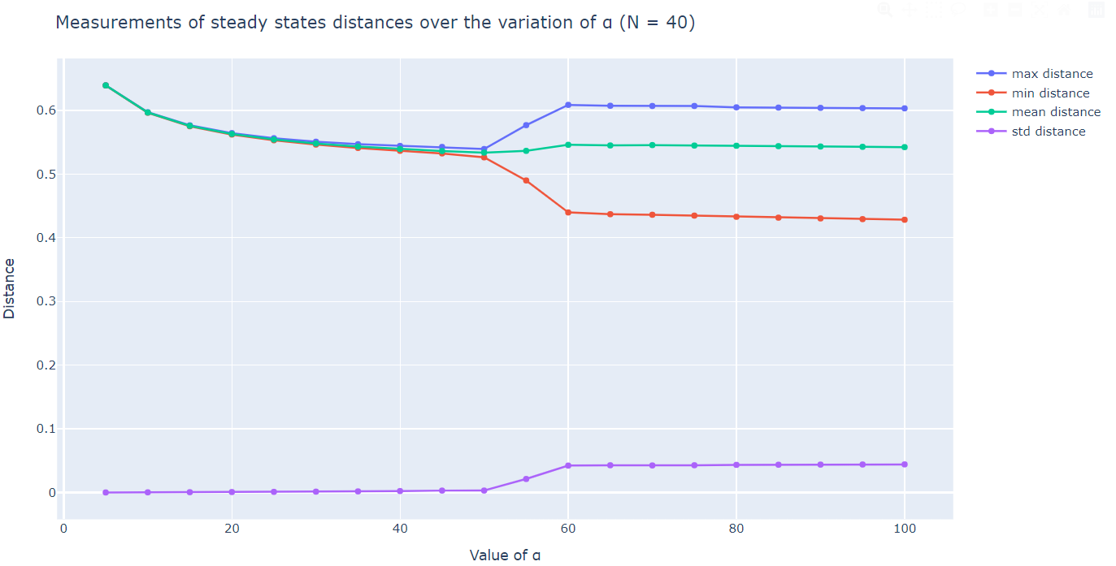
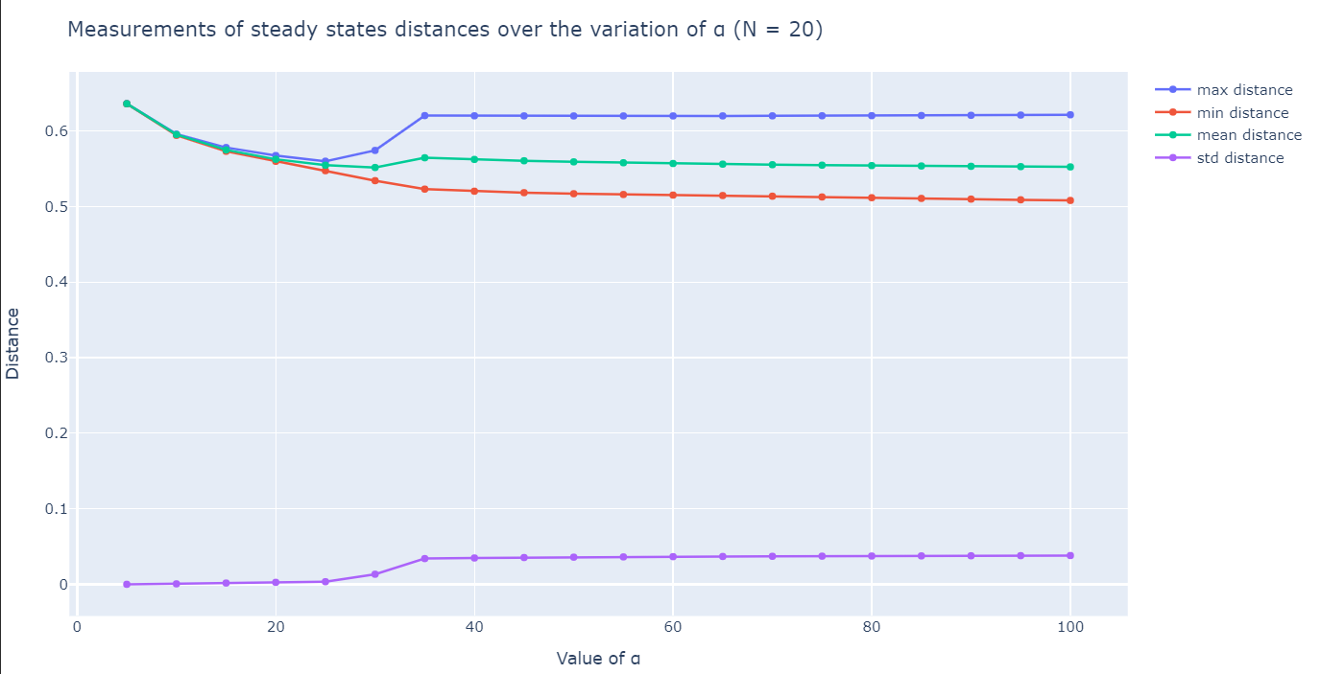
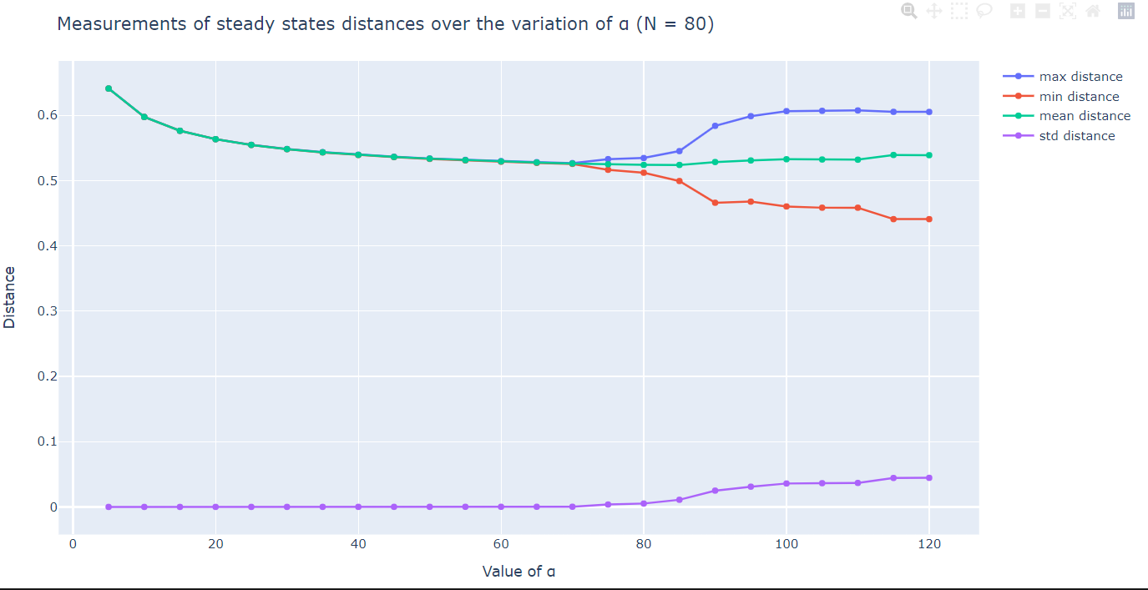
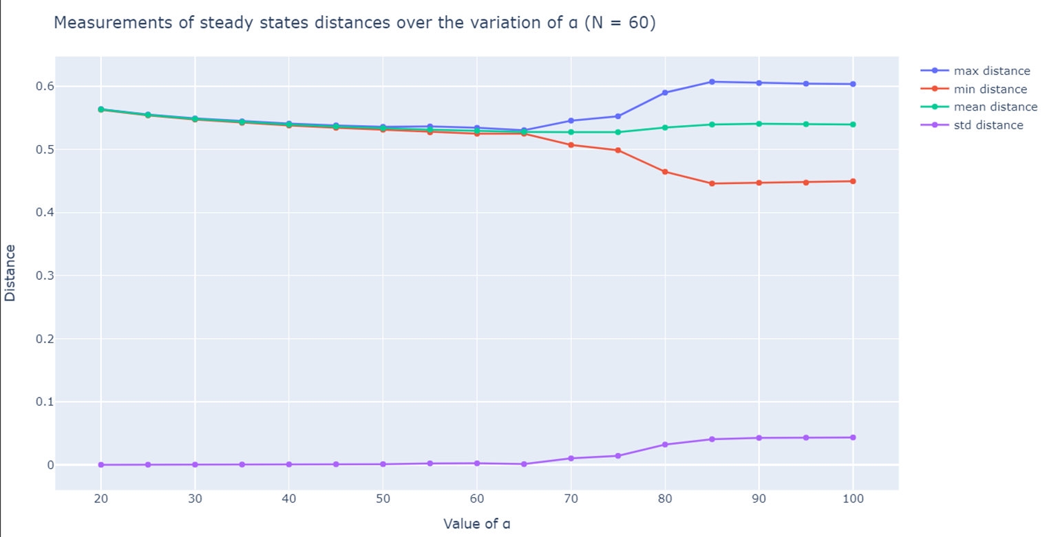
3. Does the number of particles have an influence on the behaviour of the Minimizers?

Slide 10

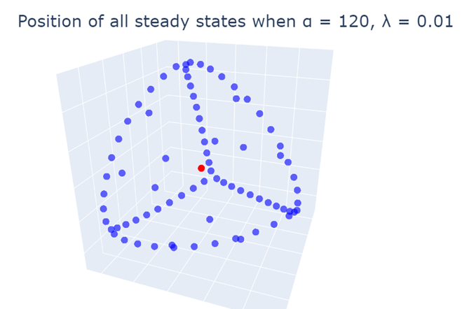
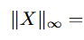
Further exploration: Other questions
When and why do we observe a break of symmetry?
How does the parameter λ affect the shape of the minimizers?
Do different initial conditions affect the results?
Does using a different solver affect the results?
What can we say about the true location of the minimizers?
6.34 x 10⁻⁷

Slide 11
